Slide 1

Spring 2019
Slides Courtesy From :
“Concepts of Programming Languages” –by Robert W. Sebesta.
Published by Pearson Education, Inc. USA. Eleventh Edition. 2016
IUBAT CSC 461

Slide 2
Introduction
Language and sentence
  Let ∑ be a set of characters. A language over ∑ is a set of strings of characters drawn from ∑.
    Alphabet = English characters
    Language = English sentences
    Alphabet = ASCII
    Language = C programs
  Each string over ∑ is a sentence
A language is a set of sentences
  For Java programming language, a Java program is a sentence
  Java programming language consists of all legal Java programs
    Infinite ?
IUBAT CSC 461

Slide 3
Introduction
A language is a set of strings of characters from some alphabet
The strings of a language are called sentences or statements
These small units are called lexemes
The lexemes of a programming language include its numeric literals, operators, and special words
Lexemes are partitioned into groups—for example, the names of variables, methods, classes
IUBAT CSC 461

Slide 4
Introduction
Each lexeme group is represented by a name, or token.
So, a token of a language is a category of its lexemes.
An identifier is a token that can have lexemes, or instances, such as sum and total
IUBAT CSC 461

Slide 5
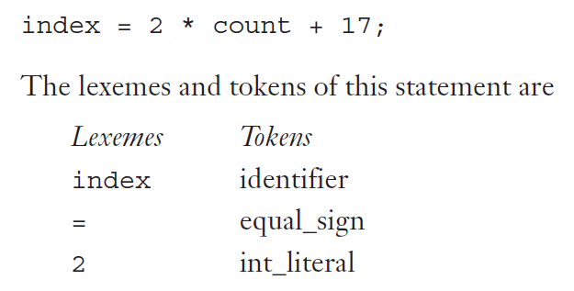
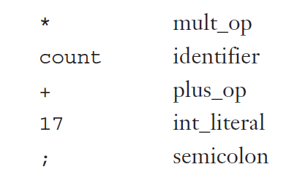
Example
IUBAT CSC 461

Slide 6
The Compilation Process
Source Program
IF (a<b) THEN c=1*d;
Lexical Analyzer
Token Sequence
IF
(
ID
“a”
<
ID
“b”
THEN
ID
“c”
=
CONST
“1”
*
ID
“d”
Syntax Analyzer
cond_expr
a
<
Syntax Tree
IF_stmt
b
lhs
list
c
assign_stmt
rhs
1
Semantic Analyzer
*
d
3-Address Code
GE a, b, L1
MUlT 1, d, c
L1:
Code Optimizer
GE a, b, L1
MOV d, c
L1:
Optimized 3-Addr. Code
loadi R1,a
cmpi R1,b
jge L1
loadi R1,d
storei R1,c
L1:
Code Generation
Assembly Code
IUBAT CSC 461

Slide 7
Describing a Programming Language
Describe programming languages-Not easy to provide a concise and precise description
Syntax:
  A study of rule for formation of grammatical sentence in language
  The syntax of a programming language is the form of its expressions, statements, and program units.
Semantic: is the meaning of those expressions, statements and program units.
Three phases
  Describing tokens
    A category of lowest level syntactic unit over alphabet
      e.g.
  Describing syntax
    The structure of program structures, expression, statements, etc.
  Describing semantics
    The meaning of the program, expression, statement, etc.
    e.g. only then-branch is executed if cond_expr is evaluated to be true
cond_expr
e
IF
ID
“a”
THEN
IF_stmt
stmt
IUBAT CSC 461

Slide 8
Regular Expression
Definition:
  The regular expressions over ∑ are the smallest set of expressions including
    ε
    `c` where c ∈ ∑
    A+B where A, B are RE over ∑
    AB where A, B are RE over ∑
    A* where A is a RE over ∑
Each RE corresponds to a regular language
  We use them interchangeably
IUBAT CSC 461

Slide 9
Examples
Keywords: “else” or “if” or “while” or …
  `else` + `if` + `while` + …
  `else` abbreviates `e` `l` `s` `e`
  keywords = { `else`, `if`, `then`, `while`, … }
Integer:
  digit = `0`+`1`+`2`+`3`+`4`+`5`+`6`+`7`+`8`+`9`
  integer = digit digit*
IUBAT CSC 461

Slide 10
Examples Around
Phones number: consider (412) 624-0000
  ∑ = digit ∪ { -, (, ) }
  area = digit³
  Exchange = digit³
  phone = digit⁴
  phone_number = '(' area ')' exchange '-' phone
Email address: student@iubat.edu
  ∑ = letter ∪ { . , @ }
  name = letter⁺
  address = name`@`name`.`name
IUBAT CSC 461

Slide 11
Describing Language Syntax
Context Free Language to describe language syntax
  RE is not powerful enough
  Using BNF (Backus-Naur Form, 1959)
      Invented to describe ALGOL 58
BNF fundamentals
  Two types of symbols
      Non-terminal symbols: BNF abstraction
      Terminal symbols: tokens
  A set of grammar rules
      LHS → RHS
IUBAT CSC 461

Slide 12
Backus-Naur Form (BNF)
A metalanguage is a language that is used to describe another language.
BNF is a metalanguage for programming languages.
BNF uses abstractions for syntactic structures
Java assignment statement, for example, might be represented by the abstraction <assign>
Definition of <assign> can be given by
  <assign> → <var> = <expression>
IUBAT CSC 461

Slide 13
Backus-Naur Form (BNF)
This particular rule specifies that
  The abstraction <assign> is defined as an instance of the abstraction <var>,
  Followed by the lexeme =,
  Followed by an instance of the abstraction <expression>.
One example sentence whose syntactic structure is described by the rule is
  total = subtotal1 + subtotal2
IUBAT CSC 461

Slide 14
Backus-Naur Form (BNF)
The abstractions in a BNF description, or grammar, are often called non-terminal symbols, or simply non-terminals
And the lexemes and tokens of the rules are called terminal symbols, or simply terminals
IUBAT CSC 461

Slide 15
Backus-Naur Form (BNF)
A grammar is a finite nonempty set of rules
A rule has one left hand symbol (LHS) and can have more than one right hand symbols
<program> → <stmts>
<stmts> → <stmt> | <stmt> ; <stmts>
<stmt> → <var> = <expr>
<var> → a | b | c | d
<expr> → <term> + <term> | <term> - <term>
<term> → <var> | const
IUBAT CSC 461

Slide 16
Backus-Naur Form (BNF)
<if_stmt> → if ( <logic_expr> ) <stmt>
<if_stmt> → if ( <logic_expr> ) <stmt> else <stmt>
Or with the rule
<if_stmt> → if ( <logic_expr> ) <stmt>
| if ( <logic_expr> ) <stmt> else <stmt>
IUBAT CSC 461

Slide 17
BNF Rules
A rule is recursive if its LHS appears in its RHS.
The following rules illustrate how recursion is used to describe lists:
<ident_list> → identifier
| identifier, <ident_list>
IUBAT CSC 461

Slide 18
From Rules to Sentences
Derivation
  A sentence can be generated by a repeat application of rules, starting from the start symbol
  Start symbol is always a non-terminal symbol
<program> => <stmts> => <stmt>
=> <var> = <expr> => a =<expr>
=> a = <term> + <term>
=> a = <var> + <term>
=> a = b + <term>
=> a = b + const
IUBAT CSC 461

Slide 19
Derivation
Every string of symbols in the derivation is a sentential form
  A sentence is a sentential form that has only terminal symbols
A leftmost derivation is one in which the leftmost non-terminal in each sentential form is the one that is expanded
IUBAT CSC 461

Slide 20
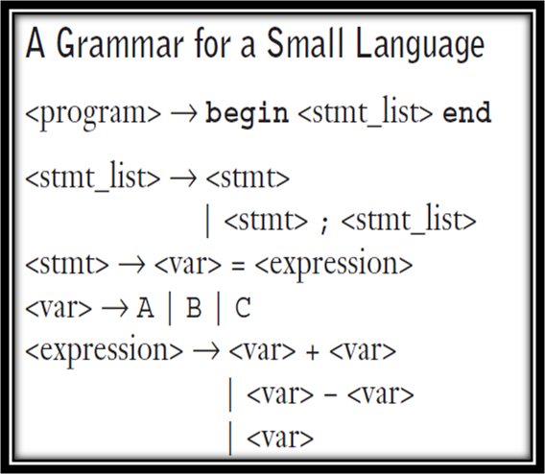
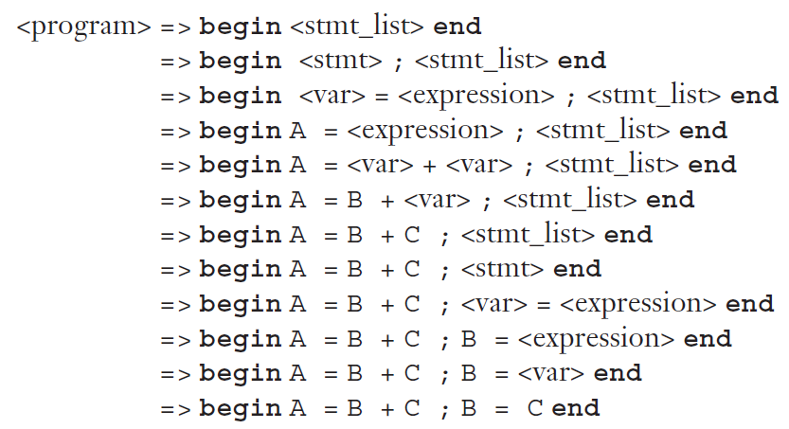
Grammars and Derivations
: Derives
Derivations are called
sentential form
Leftmost derivation
IUBAT CSC 461

Slide 21
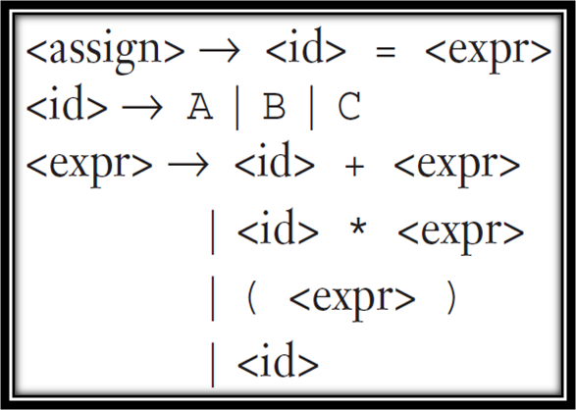
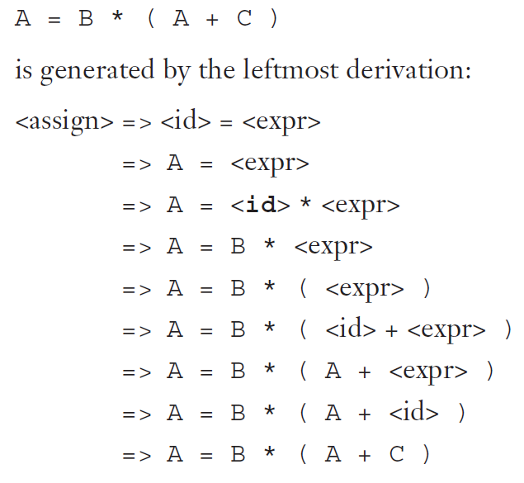
Grammars and Derivations
IUBAT CSC 461

Slide 22
Parse Tree
A hierarchical representation of a derivation
Hierarchical syntactic structure of the sentences
These hierarchical structures
are called Parse Trees
Every internal node of a
parse tree is labeled with a
non-terminal symbol
Every leaf is labeled with a
terminal symbol.
Every sub-tree of a parse tree
describes one instance of an
abstraction in the sentence.
<program>
<stmts>
<stmt>
<var>
=
<expr>
a
<term>
+
<term>
<var>
const
b
IUBAT CSC 461

Slide 23
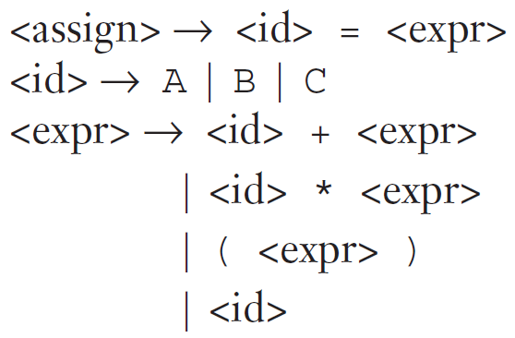
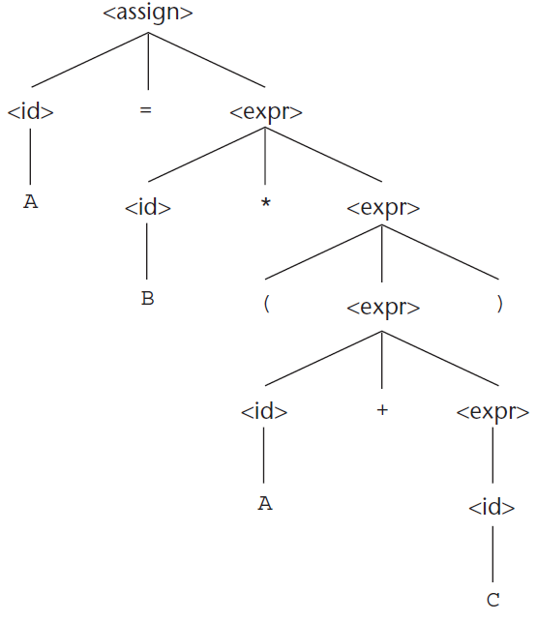
Parse Tree of A=B*(A+C)
A=A*(B+(C*A))
A=A*(B+(C))
IUBAT CSC 461

Slide 24
Ambiguous Grammar
  <expr> → <expr> <op> <expr> | const
  <op> → / | -
<expr>
<expr>
<expr>
<op>
<expr>
<expr>
<op>
<expr>
<expr>
<op>
<expr>
<expr>
<op>
<expr>
const
-
const
/
const
const
-
const
/
const
IUBAT CSC 461

Slide 25
Ambiguity
A grammar is ambiguous if and only if it generates a sentential form that has two or more distinct parse trees
We can rewrite the grammar to
remove the ambiguity
    <expr> → <expr> - <term>
    | <term>
    <term> → <term> / const
    | const
  Ambiguity is related to the
  grammar not the language
<expr>
<expr>
-
<term>
<term>
<term>
/
const
const
const
IUBAT CSC 461

Slide 26
Removing Ambiguity
Introducing associativity and precedence
When an expression includes two operators that have the same precedence (as * and / usually have)—for example, A / B * C—a semantic rule is required to specify which should have precedence. This rule is named associativity.
When an expression includes two different operators, for example, x + y * z, assigning different precedence levels to operators is important. For example, the multiplication operator is generated lower in the tree, which could indicate that it has precedence over the addition operator in the expression
  ambiguous:
    <expr> -> <expr> + <expr> | const
  unambiguous:
    <expr> -> <expr> + <term> | <term>
    <term> → <term> / const| const
IUBAT CSC 461

Slide 27
Extended BNF
Optional parts are placed in brackets [ ]
<proc_call> -> ident [(<expr_list>)]
Alternative parts of RHSs are placed inside parentheses and separated via vertical bars
<term> → <term> (+|-) const
Repetitions (0 or more) are placed inside braces { }
<ident> → letter {letter | digit}
IUBAT CSC 461

Slide 28
BNF and EBNF
BNF
  <expr> → <expr> + <term>
  | <expr> - <term>
  | <term>
  <term> → <term> * <factor>
  | <term> / <factor>
  | <factor>
EBNF
    <expr> → <term> {(+ | -) <term>}
  <term> → <factor> {(* | /) <factor>}
IUBAT CSC 461

Slide 29
Describing Language Semantics
Attribute grammar
An attribute grammar is an extension to a context-free grammar.
The extension allows certain language rules to be conveniently described, such as type compatibility rule
In Java, for example, a floating-point value cannot be assigned to an integer type variable, although the opposite is legal.
Describing static semantics
These problems exemplify the categories of language rules called static semantics rules. The static semantics of a language is only indirectly related to the meaning of programs during execution. Many static semantic rules of a language state its type constraints.
Describing dynamic semantics
  Operational semantics
  Axiomatic semantics
  Denotational semantics
IUBAT CSC 461

Slide 30
Example
    E → T + E1 {E.val = T.val + E1.val}
    E → T {E.val = T.val}
    T → int * T1 {T.val = int.val * T1.val}
    T → int {T.val = int.val}
Context Free Grammar
Semantic actions
attributes
IUBAT CSC 461

Slide 31
Two Types of Attributes
P
c₁
c₂
c₃
c₄
Synthesized attributes: values are computed from ones of the children nodes
Synthesized of P = f(c₁, c₂, c₃, c₄)
P
S₁
S₂
S₃
S₄
Inherited attributes: values are computed from attributes of the siblings and parent of
the node
Inherited of S₄= f(P, S₁, S₂, S₃)
  semantic rules create dependencies between attributes represent the dependencies as a graph from the graph, derive evaluation order for semantic rules
IUBAT CSC 461

Slide 32
Example
A
A
D
E
F
D
E
F
b is synthesized attribute of A
A→DEF
c_{i}’s attributes of D, E, F
b is Inherited attribute of D
D→AEF
c_{i}’s attributes of A, E, F
  Terminal symbols – have synthesized attributes only
  Start symbol – is assumed not to have any inherited attributes
Synthesized/Inherited attributes are naturally computed bottom-up/top-down, respectively
IUBAT CSC 461

Slide 33
The Attributes for the Non terminals
actual_type
A Synthesized attribute associated with the non terminals <var> and <expr>. In the case of an expression, it is determined from the actual types of the child node.
expected_type
An Inherited attribute associated with the non terminal <expr>. determined by the type of the variable
IUBAT CSC 461

Slide 34
Example
To check the type rules of a simple assignment statement.
  The syntax and static semantics of this assignment statement are as follows:
  1. The only variable names are A, B, and C.
  2. The right side of the assignments can be either a variable or an expression in the form of a variable added to another variable.
  3. The variables can be one of two types: int or real.
  4. When there are two variables on the right side of an assignment, they need not be the same type.
  5. The type of the expression when the operand types are not the same is always real.
  6. When they are the same, the expression type is that of the operands.
  7. The type of the left side of the assignment must match the type of the right side.
  The syntax portion of our example attribute grammar is
<assign> → <var> = <expr>
<expr> → <var> + <var> | <var>
<var> → A | B | C
IUBAT CSC 461

Slide 35
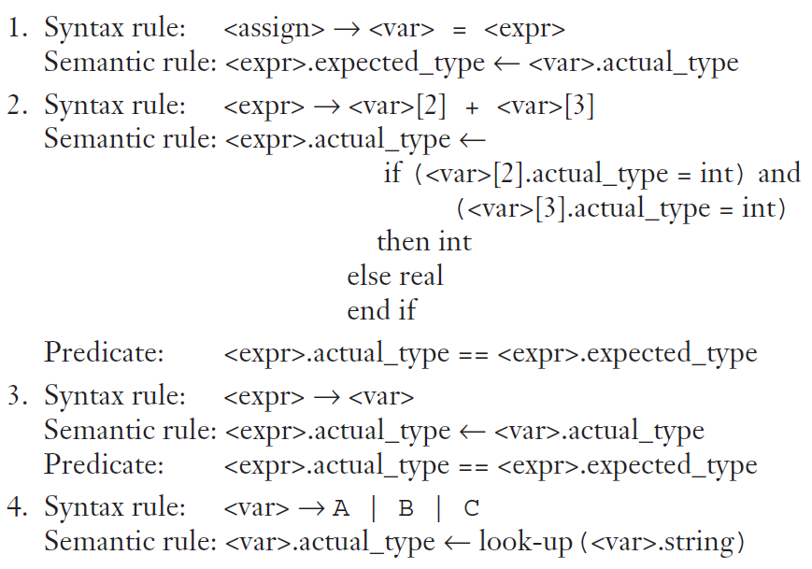
The look-up function looks up a given variable name in the symbol table and returns the variable’s type.
IUBAT CSC 461

Slide 36
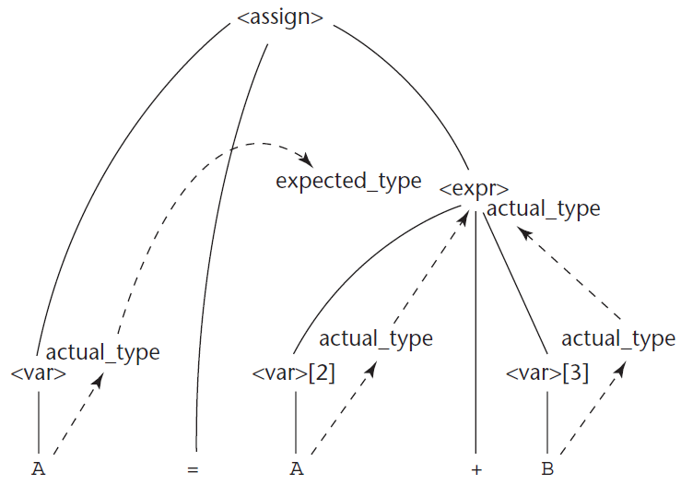
The flow of Attributes in the Tree
IUBAT CSC 461

Slide 37
Dynamic Semantics
I: Operational semantics
  Describe the meaning of a program by executing its statements on a machine, either simulated or actual. The change in the state of the machine (memory, registers, etc.) defines the meaning of the statement
  Example
    C- statement:
    for (expr1; expr2; expr3) {
    . . .
    }
Meaning
expr1;
loop: if expr2 == 0 goto out
. . .
expr3;
goto loop
out: . . .
IUBAT CSC 461

Slide 38
Discussion
Describing operational semantics requires a real or virtual machine
  Interpreting the operation using instructions from a computer
    Machine-dependent
    May not be easy to understand
  Interpreting using instructions from an idealized computer
    Definition of lower level computer required
    Translator required
Evaluation
  Good if used informally
  Extremely complex if used formally (e.g., VDL), it was used for describing semantics of PL/I.
IUBAT CSC 461

Slide 39
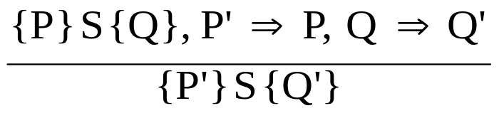
II: Axiomatic Semantics
Originally
  Based on formal logic (predicate calculus)
  For formal program verification
Form
  Assertions
    Pre-, post- conditions: {P} statement {Q}
  {b > 0}
  a = b + 1
  {a > 1}
  Axioms (logical statement that is assumed to be true)
    Inference rules
      how to interpreting …
(Is a method of inferring the truth of one
assertion on the basis of the values of other assertion.)
IUBAT CSC 461

Slide 40
Pre- and Post- Condition
Let us look at a simple axiom for assignment “X=E”
  From post-condition to find the weakest pre-condition
  P = Q _{X→E} replacing the appearance of X in Q using E
  example:
  {?} a = b/2-1 {a<10}
A more complicated example
{?}
a=3;
if (a>2)
a=b+1;
else
a=b+1;
{a>10}
IUBAT CSC 461

Slide 41
Evaluation of Axiomatic Semantics
Developing axioms or inference rules for all of the statements in a language is difficult
Good for correctness proofs, for reasoning about programs
Limited power for language designers or compiler writers
IUBAT CSC 461

Slide 42
III: Denotational Semantics
Based on recursive function theory
The most abstract semantics description method
Originally developed by Scott and Strachey (1970)
IUBAT CSC 461

Slide 43
Building Denotational Specification
The state of a program is the values of all its current variables
s = {<i₁, v₁>, <i₂, v₂>, …, <i_{n}, v_{n}>}
Let VARMAP be a function that, when given a variable name and a state, returns the current value of the variable
VARMAP(i_{j}, s) = v_{j}
IUBAT CSC 461

Slide 44
Building Denotational Specification
The process of building a denotational specification for a language
  Define a mathematical object for each language entity
  Define a function that maps instances of the language entities onto instances of the corresponding mathematical objects
The meaning of language constructs are defined by only the values of the program's variables
  In denotational semantics, the state changes are defined by rigorous mathematical functions
  In operational semantics, the state changes are defined by coded algorithms
IUBAT CSC 461

Slide 45
Example
We use a very simple language construct, character string representations of binary numbers, to introduce the denotational method. The syntax of such binary numbers can be described by the following grammar rules:
<bin_num> → '0'
| '1'
| <bin_num> '0'
| <bin_num> '1'
IUBAT CSC 461

Slide 46
A parse tree of the binary number 110
The syntactic domain of the mapping function for binary numbers is the set of all character string representations of binary numbers.
The semantic domain is the set of nonnegative decimal numbers, symbolized by N. To describe the meaning of binary numbers using denotational semantics, we associate the actual meaning (a decimal number) with each rule that has a single terminal symbol as its RHS.
In our example, decimal numbers must be associated with the first two grammar rules. The other two grammar rules are, in a sense, computational rules
<bin_num>
<bin_num>
0
<bin_num>
1
1
IUBAT CSC 461

Slide 47
A parse tree of the binary number 110
The semantic function, named Mbin, maps the syntactic objects, as described in the previous grammar rules, to the objects in N, the set of nonnegative decimal numbers. The function Mbin is defined as follows:
Mbin('0') = 0
Mbin('1') = 1
Mbin(<bin_num> '0') = 2 * Mbin(<bin_num>)
Mbin(<bin_num> '1') = 2 * Mbin(<bin_num>) + 1
The meanings, or denoted objects (which in this case are decimal numbers), can be attached to the nodes of the parse tree shown on the tree in Figure. This is syntax-directed semantics. Syntactic entities are mapped to mathematical objects with concrete meaning.
6
<bin_num>
3
<bin_num>
0
1
<bin_num>
1
1
IUBAT CSC 461

Slide 48
Evaluation
Can be used to prove the correctness of programs
Provides a rigorous way to think about programs
Can be an aid to language design
Has been used in compiler generation systems
Because of its complexity, they are of little use to language users
IUBAT CSC 461

Slide 49
Summary
Describing programming languages
  Describing tokens
    Using RE
  Describing syntax
    Using BNF/CFG
  Describing semantics
    Static semantics
      Using attributed grammar
    Dynamic semantics
      No widely accepted approaches
      Three possible ways:
        operational, axiomatic, denotational
IUBAT CSC 461

